Slide 1
PES classification schema
Transformation of the PES classification schema
Tenforce
ESCO – mapping pilot – WS 2 (2014-09-08)

Slide 2
Overview
FR: ROME v3.21
NL: UWV REF-schetsen+sectoren
ES: Clasificación Nacional de Ocupaciones CNO-2011
CZ: Národní Soustava Povolání

Slide 3
FR: ROME v3.21 (started)
Input
Complete formal structure was provided (XML based)
Occupation classification with 2 top level tree structures (Sector, ROME code), mapped to ISCO-08, NO mapping to NACE rev 2
Competence classification (S/C), typed as knowledge (theory) or skill (practical)
Activities (task) register (ACT), typed as base task, specific task and base or specific task
Work environment or context (W), typed as Condition, Sectorial or Organizational
Occupation profile detailing and grouping S/C, ACT and W per occupation
Transformation remarks
All classification systems are mapped
The profile
Was used to get alternate names for occupations (appellation@fr)
Relationship with competence is either basic (essential) or specific (optional)
The grouping structure of specific competences was flattened

Slide 4
FR: ROME v3.21 (continued)

Slide 5
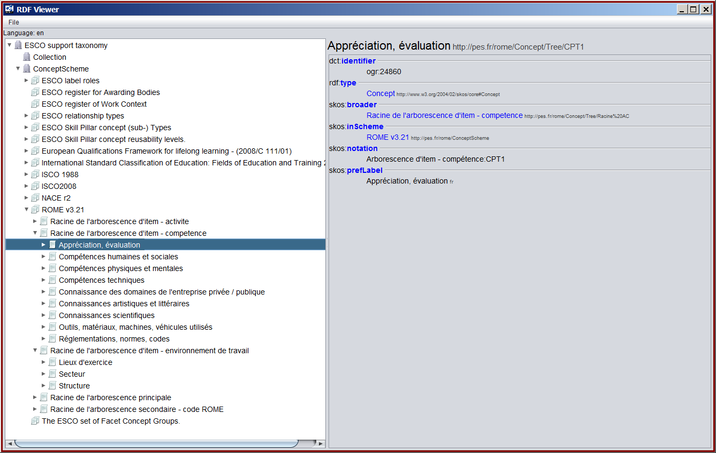
FR: ROME v3.21 (completed)

Slide 6
NL: UWV (started)
Input
Informal an incomplete structure (CSV based)
Occupation (OCC) classification with 2 top level tree structures (Sector, Cluster), mapped to ISCO-08, NO mapping to NACE rev 2
Competence classification (S/C), typed as behavior, OCC-specific or technical
Activities (task) register (ACT), typed as ‘main task’ and ‘task’
Work environment or context (W) (no structure was provided)
Specializations of OCC
Transformation remarks
All provided classification systems are mapped, occasional hierarchy may be missing
The relationships
OCC.Cluster – S/C.behavior relationships are typed as always, often or maybe
OCC.Cluster are related to S/C.technical
OCC are related to S/C.OCC-specific
OCC Specializations are mapped as alternate labels

Slide 7
NL: UWV (continued)

Slide 8
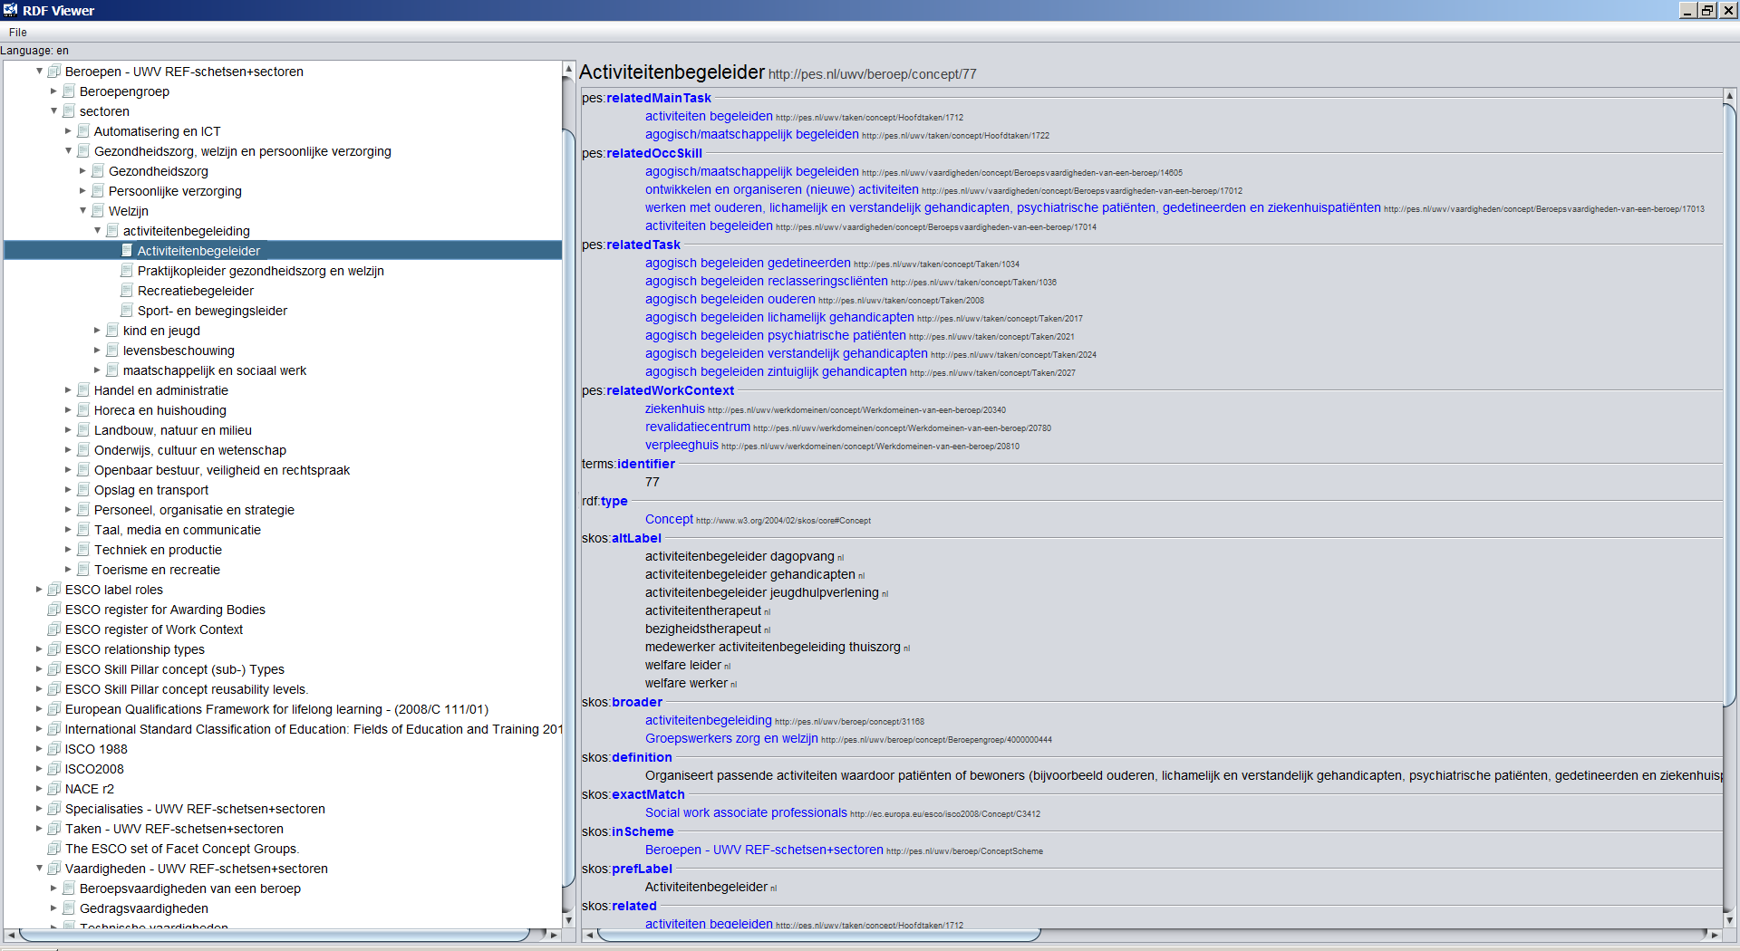
NL: UWV (concluded)

Slide 9
ES: CNO-2011 (started)
Input
Informal an incomplete structure (CSV based)
Occupation (OCC) classification with 1 top level tree structures, mapped to ISCO-08, NO mapping to NACE rev 2
Nodes of the top level structure are provided in English
OCC are provided with English and Spanish label.
Transformation remarks
The OCC (CNO) classification systems is mapped to a SKOS representation
The relationships
Relationship with ISCO-08 is mapped to skos:broaderMatch

Slide 10
ES: CNO-2011 (continued)

Slide 11
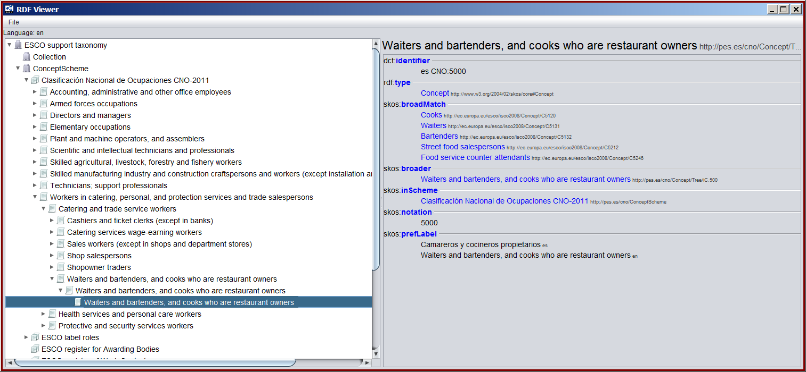
ES: CNO-2011 (completed)

Slide 12
CZ: Národní Soustava Povolání (contimued)
Input
Informal an incomplete structure (CSV based)
Occupation (OCC) classification with 1 top level tree structures, mapped to ISCO-08 mapped to CZ-NACE, NO mapping to NACE rev 2 except for HOSIPI mapped to EQF
Transformation remarks
The OCC (CNO) classification systems is mapped to a SKOS representation
The relationships
Relationship with ISCO-08 is mapped to skos:broaderMatch
CZ-NACE with code 18 is mapped to NACE rev 2 codes ‘I’ and ‘79’
OCC are mapped to EQF level

Slide 13
CZ: Národní Soustava Povolání (continued)

Slide 14
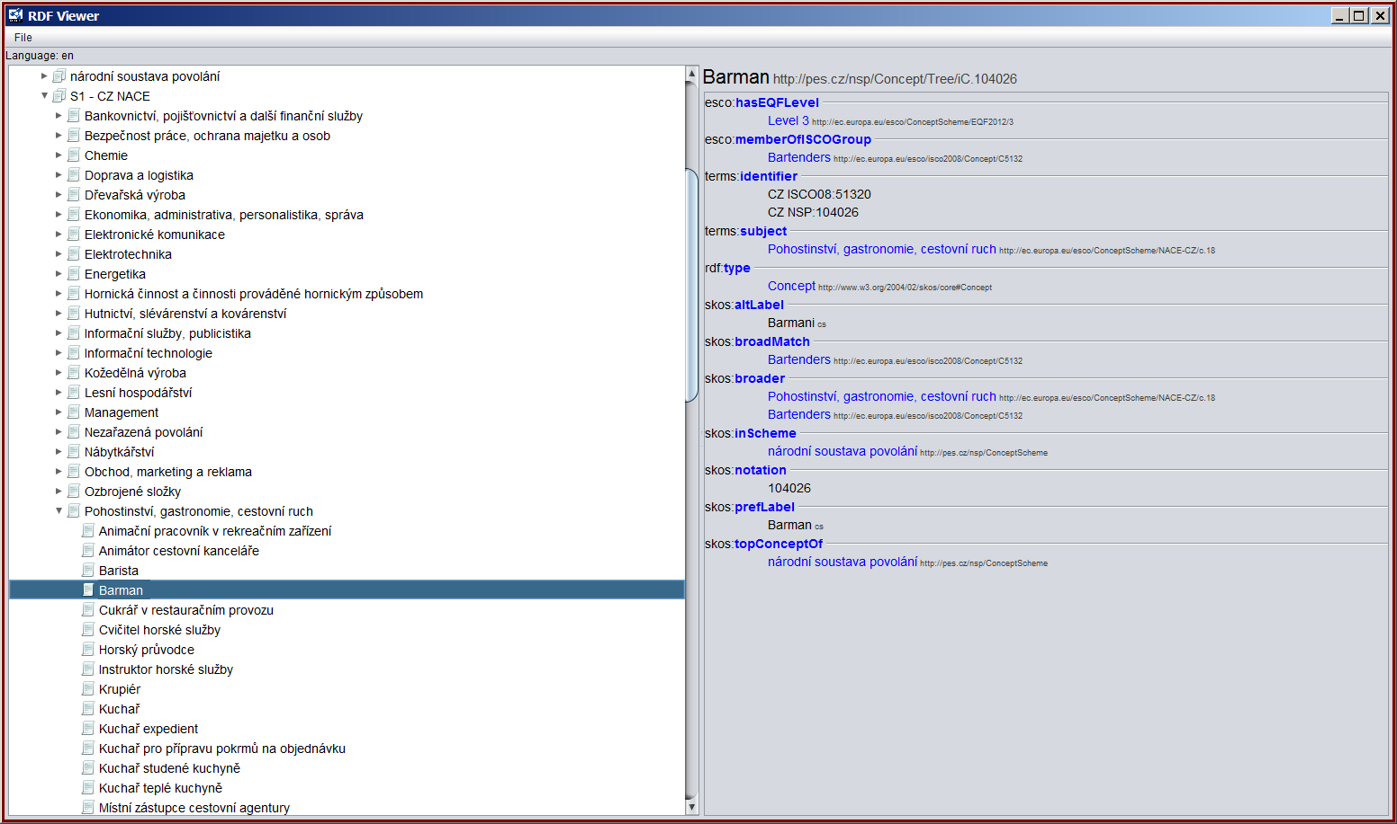
CZ: Národní Soustava Povolání (completed)

